Slide 1

Introduction to
Field Programmable Analog Arrays (FPAA)

Slide 2
Agenda
Analog Design Today & FPAA Concept
Overview of Analog Circuits & FPAA alternative
General FPAA overview
Anadigm FPAA AN221E04 Architecture
FPAA Features
Anadigm Designer® 2 Software and features
Sensor Interfacing
Applications of FPAA
Benefits of FPAA Design technology
Conclusion

Slide 3
Analog Designs Today
Analog design traditionally requires a high level of expertise
  Design, implementation and test expertise
  The devil is in the implementation details
Repurposing an analog design or customizing analog front-end is cumbersome
The analog portion of the design is isolated from the system processor

Slide 4
Who Needs Analog Circuits ?
“Real” world is primarily analog in nature
Almost every digital system which directly interacts with the real world must have analog-to-digital (A/D) and digital-to-analog (D/A) interfaces
These interfaces may be simple A/D and D/A converters,
or ...
They can contain quite sophisticated signal conditioning systems

Slide 5
Why, are Analog Circuits and systems so widely avoided ?
Design of analog circuits is difficult, often involves rare expertise, and is very hard to automate
System analog design is even harder: a “standard cell” or “gate” approach is rather uncommon – consequently analog system designers must consider low-level circuit interactions
Analog systems suffer several kinds of dependencies (on the temperature, fabrication run, time (aging))
Analog systems have finite precision

Slide 6
Digital Counterpart
Even if a digital solution exists and is economically acceptable, an analog solution may turn out to be
  Smaller
  require less power
  generate less noise, and
  be more reliable (a smaller number of elements to go wrong)

Slide 7
FPAA Alternative
Analog designs can be greatly simplified by Field Programmable Analog Arrays (FPAA).
Design process would consist of selection of predesigned cells in the FPAA structure
Programming their functions and parameters, and
Programming signal interconnections between the cells

Slide 8
Impact of FPAA
Simplifies the analog design process.
Reduces the time for analog design implementation from months to minutes
Enables repurposing and real-time updating of analog functions within the system FPAA
FPAA = Analog FPGA

Slide 9
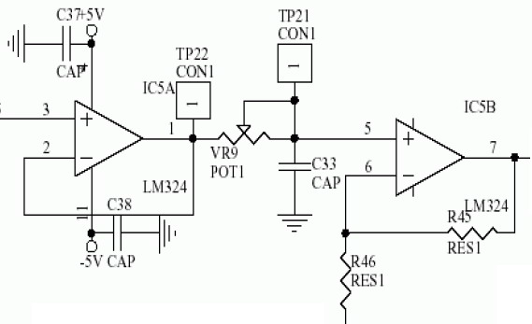
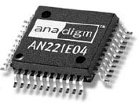
The Solution is Here..!!!
Circuits like this..???
Will be like this..!!

Slide 10
FPAA Architecture/Types
FPAA
Switched capacitor based Current mode based

Slide 11
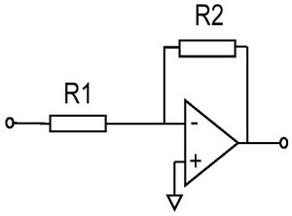
How FPAA Work ?
The key element in Analog design is a OP-AMP and would be…..
FPAA has OP-AMPs as analog processor.
An OP-AMP can be used in various circuit configurations, with the help of resistors.
The resistor values and configuration is not done with switch capacitor technology.

Slide 12
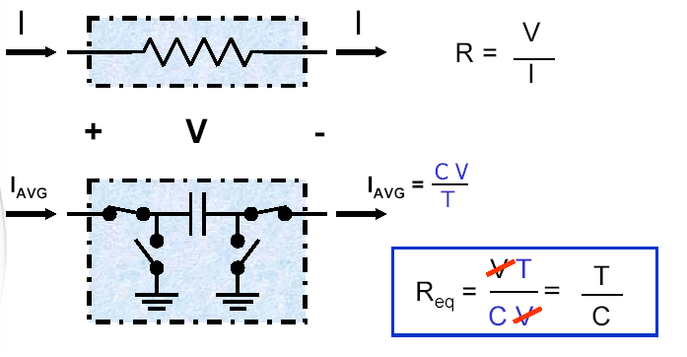
Switched Capacitor Technology
A design technique that implements an “equivalent resistance” by alternately switching the inputs of a capacitor
Resistance value depends upon the ratio of capacitors; NOT the absolute value
Advantages
Much larger resistance values for a given area
Capacitor ratios are largely temperature and process independent
Better “resistor” values

Slide 13
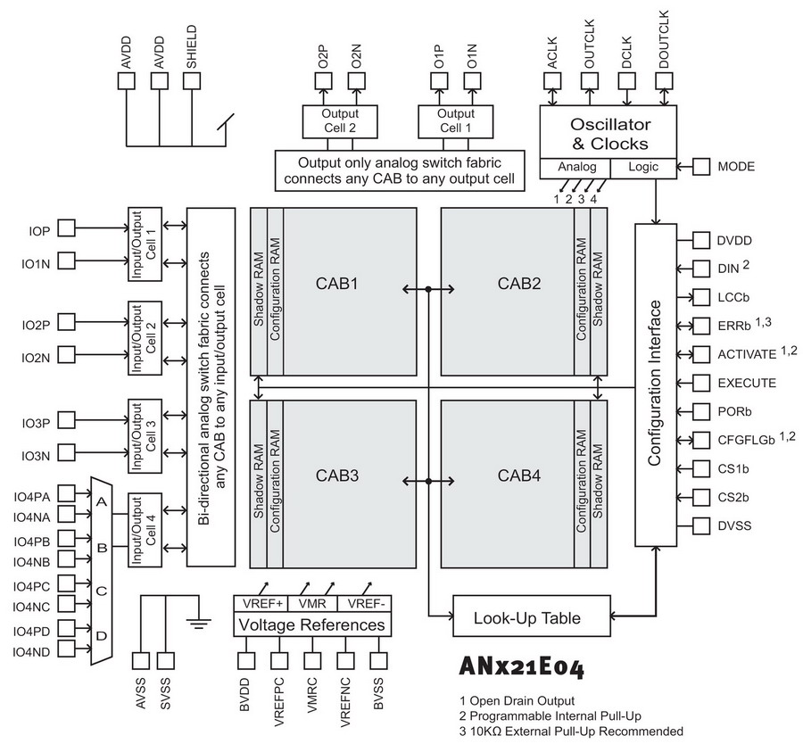
AN221E04 Architecture
Contains
CABs
I/O blocks
Shadow RAM
Configuration RAM
Switch matrix
Programming interface
Etc….
A FPAA from Anadigm, USA

Slide 14
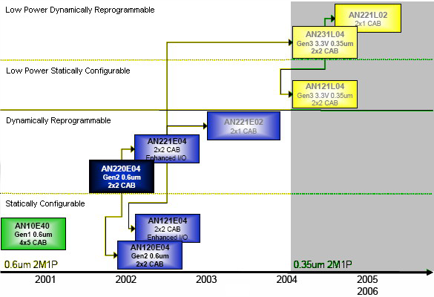
Anadigm FPAA Roadmap

Slide 15
AN221E04 Features
Fully differential architecture
Four (4) I/Os
  Can be configured as full-featured inputs or simple outputs
Integrated 8-bit SAR-ADC
Two (2) Differential outputs
256-Byte Look-Up Table (LUT)
  For linearization/arbitrary signal generation
Low input offset:
  DC offset <100µV
Signal to Noise Ratio (SNR)
  Broadband 80dB
  Narrowband (audio) 100dB
Typical Bandwidth:
  DC- 2MHz (Bandwidth is CAM dependent)

Slide 16
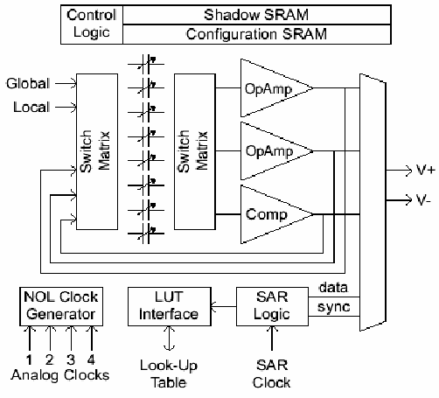
Configurable Analog Blocks (CAB)
Two (2) differential op-amps
One (1) differential sampling
comparator
Eight (8) differential, programmable capacitor banks
Successive Approximation Register (SAR) logic
  Used to implement an 8-bit, internal SAR-ADC using the comparator
Extremely versatile switching and internal routing network

Slide 17
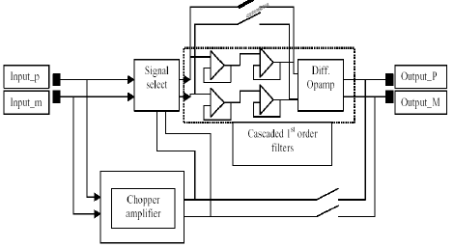
Input Blocks
Single ended or differential configuration
User can incorporate
  Chopper Amplifier
  Unit Gain Differential amplifier
  Low Pass Filter stage

Slide 18
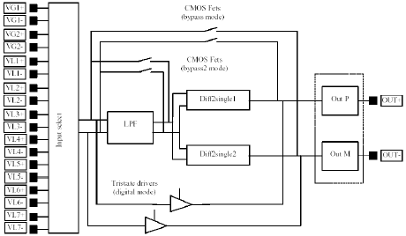
Output Block
Differential output
Analog or digital
Can include a anti aliasing low pass filter with corner frequency range of 76 to 470KHz

Slide 19
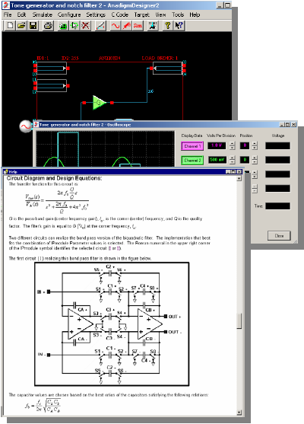
Anadigm Designer2
Easy-to-Use
Intuitive “drag-and-drop” user interface
Built-in signal generator, oscilloscope
Built-in, accurate discrete-time behavioral simulator
Extensive help documentation

Slide 20
CAD Design Flow for FPAA
Circuit design using CAMs in schematic
Decomposition & Synthesis
Placement & Routing
Macro Models
Verification/Simulation
Meet all specs
Configuration bit file generation

Slide 21
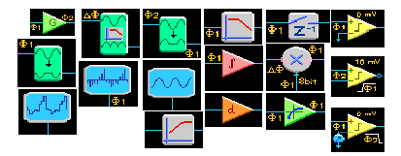
Configurable Analog Modules (CAMs)
Circuit building blocks abstracted to a functional level
  Gain Stages
  Summing Stages
  Rectifiers
  Filters etc
Each CAM is adjustable

Slide 22
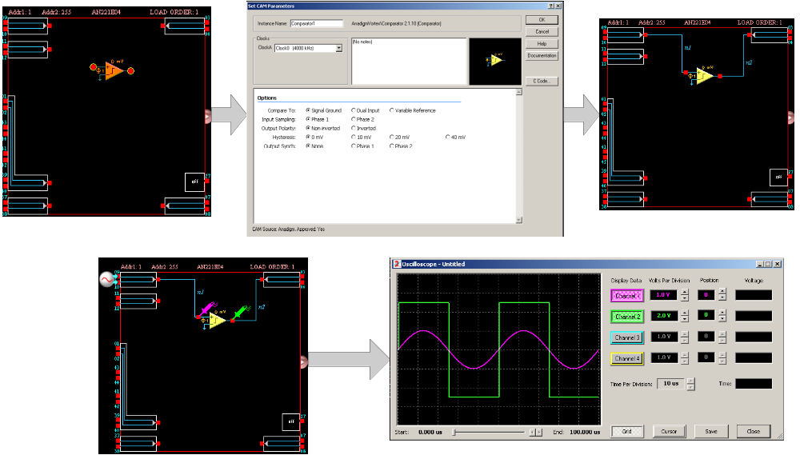
Building and Simulating a Circuit

Slide 23
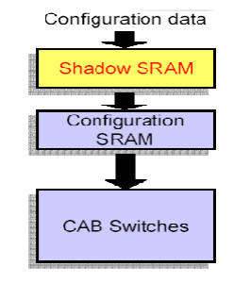
Dynamic Reconfiguration
Each CAB has two RAM blocks
  Configuration SRAM
  Shadow SRAM
After power-up, data moves from the outside world
  To the Shadow SRAM
  Then to the Configuration SRAM
While the device is operating
  The contents of the Shadow SRAM can be updated without impacting device operation
Shadow SRAM contents can be transferred to Configuration SRAM ‘on-the-fly’
What’s the use..??

Slide 24
Sensor Interfacing

Slide 25
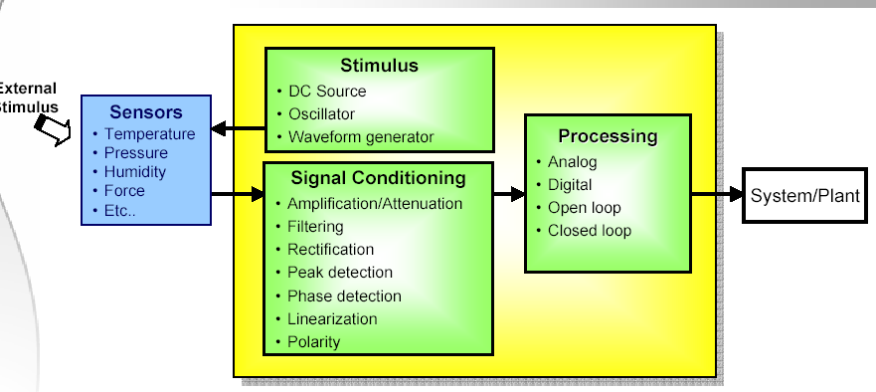
Sensor Signal Conditioning
System Design Challenges
  Sourcing stable references and stimulus
  Multiple sensors with differing signal conditioning needs
  Methods of calibration and maintenance
  Manufacturing considerations

Slide 26
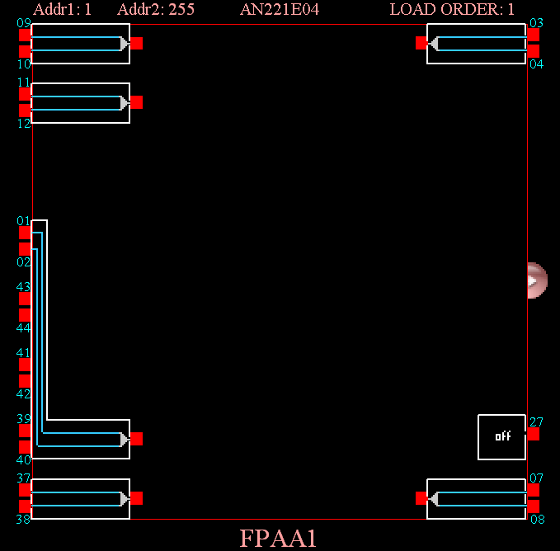
Sensor Interfacing
Sensor interfacing & processing is key concern for FPAAs.
1 I/O cell specifically designed with 4 MUXed I/Ps.
User can select each input by dynamic re-configuration.

Slide 27
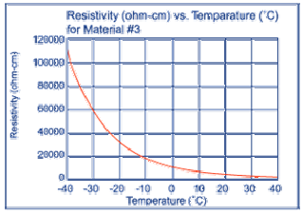
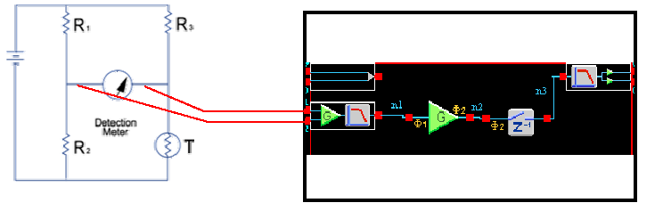
Thermistor
Resistances range from 100 to 1Mohm
Typical current < 100uAto avoid self-heating

Slide 28
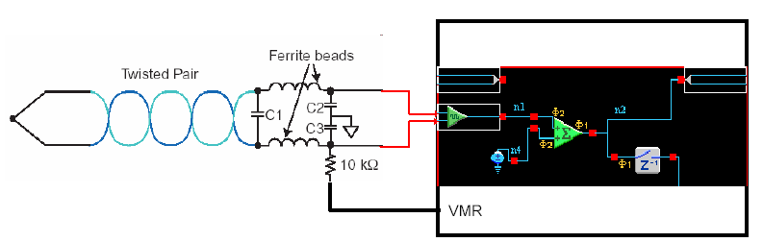
Thermocouple
Small voltage/degree C
Prone to high levels of CM noise

Slide 29
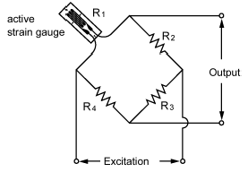
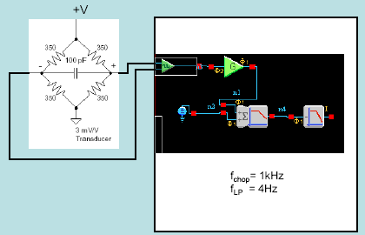
Strain Gauge
Typical output <10 mV/V
“Half bridge” has strain gauges in two arms:
  doubles the output and compensates for thermal effects
“Full bridge” has strain gauges in four arms:
  re-doubles output and compensates for thermal effects

Slide 30
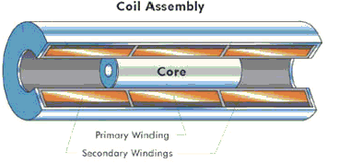
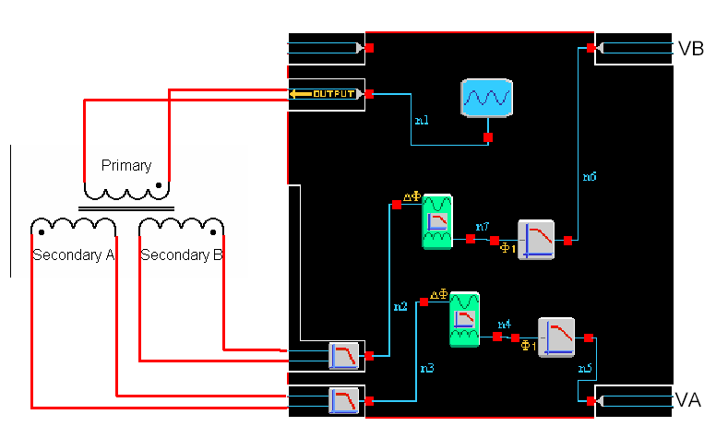
LVDT
Sensitivity ranges:
  0.05 mV/V/0.001” for long stroke LVDTs
  10 mV/V/0.001” for short stroke LVDTs
Various signal processing techniques (eg):
  Rectify and filter AC signals, then:
  Calculate (VA + VB)/Vprimary ( insensitive to the amplitude of the driving signal,and gives some noise rejection).
  Calculate the ratio of the difference and the sum of the secondary voltages i.e. (VA – VB) / (VA+VB)
  Measure the phase of the combined VA + VB secondary voltage i.e. - 180 degrees at one extreme, zero degrees at the null position, and + 180 degrees at the other extreme.

Slide 31
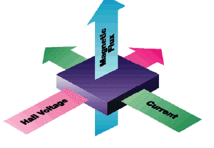
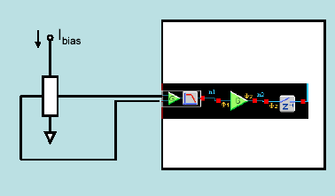
Magnetic Sensing
Usually driven with a constant current
Differential output voltage, superimposed on a common-mode voltage approximately equal to half the excitation voltage.
Typical sensitivity:
  1-100 mV/kG (Refrigerator magnet: 200 gauss)
Typical element resistance:
  1 to 10 ohms
Typical excitation current:
  20 to 200 mA.
Typical linearity:
  0.1% to 2%.

Slide 32
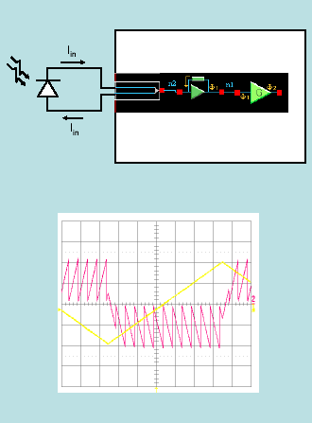
Photodiode/ Phototransistor
Photo-generated current develops a voltage across a feedback “ resistor”
Transimpedance is dependent on absolute capacitor values, not a capacitor ratio
Transimpedance CAM output is only valid at the end of each clock phase
  follow by an appropriate CAM

Slide 33
FPAA Uses and Application
Complex analog filtering circuits
Closed loop control systems
Sensor signal conditioning
Intelligent sensors
Real-time software control of analog system peripherals
Adaptive DSP front-end
Adaptive industrial control and automation
Self-calibrating systems
Compensation for aging of system components
Dynamic recalibration of remote systems
Ultra-low frequency signal conditioning
Custom analog signal processing
……and many more

Slide 34
Benefits of FPAA design technology
Simplify analog design and implementation
  Fully documented, repeatable analog design
  Reconfiguration reduces design risk and allows field updates
Platform-based design approach
  Consolidate the manufacturing of multiple boards by merely using a different configuration file
Consolidate of multiple discrete components on a Board
  Reduce board space
  Simplify manufacturing
Reduce inventory sourcing and management costs
  Increase system reliability and MTBF
  High-precision, drift-free operation
Dynamic reconfiguration allows for truly innovative analog systems design

Slide 35
Conclusion
With notable progress in FPAAs in the past few years; analog functions are getting in total control of designers.
Looking at the Time To Market (TTM) requirements of products, new-generation dynamically reprogrammable FPAAs are ready to revolutionize the analog world.

